Slide 1
Modern Gods
Journalism & The Internet in the 21st Century

Slide 2
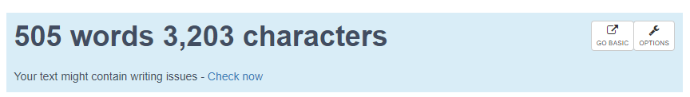
Analysis of the Text
Since the subsection doesn’t go into much detail, the main aim of this presentation will be to look closely at & dissect the details of what it does say (to question what is said, what is omitted, what is glossed over, & of course, why) & to answer the two questions related to it posed to us at the end:
How is internet used as a source of news? How do journalists ensure creditability while quoting sources from the internet?
Discuss the importance of archiving in modern journalism. Is technology making the process of archiving easier? Explain.
Notes:
The subject matter at hand is extremely vast, but at 505 words, the text discussing it is not.

Slide 3























“Use of Internet as a source of News
The revolution brought about by the advent of Internet has given rise to many technological innovations in the journalism and media industry. We can see a huge transformation in the way the news is being disseminated among the masses. This has also opened the floodgates of opportunities for the media societies to reach out to their audience. The Internet, along with other digital transformations, has affected journalism practices to a large extent and opened up great avenues for enhancements in terms of efficiency and effectiveness.
• The influence of internet can be seen in every facet of journalism. From information gathering to news editing, the internet has revolutionized the media industry. Today, the journalists are rarely seen using notepads and pens, as most of their research and note-taking happens on internet-enabled devices. Therefore, most of the logistics used for distribution and communication in the past is getting redundant today.
• The speed and reach of internet connectivity in the remote areas has made information dissemination faster and effective. It has not only improved the journalists’ production efficiency and pace, but also shaped up their narratives with new writing techniques and better coverage across variety of platforms. Covering live events and incidents has become way more informal and easier, as compared to the conventional style of journalism. The dissemination of news on the digital channels is in sync with the event taking place live.
• With a vast amount of information at one place, Internet gives innumerable possibilities of enhancing a journalist’s work in terms of both quality and scope. Journalists can unleash their creative proficiencies more than ever, by using various services and tools available on web. These tools help them to research the stories, vet that research and finally analyse that research.
• With the digitization, contemporary form of journalism involving core journalism skills can be transcended to better heights with the blend of technical knowledge and the ability to create online media content. Traditional sources are limited by time and/or space and cost. Digital age has made the scope of journalism infinite, as Internet offers unlimited information through various content formats, with a plurality of views being represented from a diverse set of people. Work from the past can be readily linked, and even the content from the past decades hosted in the digital archives can be leveraged (to depict the historical events) and, hence, can be used as citations in the current work.
• Technology has enhanced the processes of recognizing stories that are newsworthy, as this gives an outlook of what is trending across the world. The feeds from Facebook, Twitter and other social networking sites provide a snapshot of events which are happening around the world. The blogs and citizen news sources offer perspectives of the witnesses, the public and from the live location much faster than print, television or any other media.
• Audience control, nonlinearity, storage and retrieval, unlimited space, immediacy, multimdedia capability, interactivity and user-generated content are certain other aspects that web has enabled in journalism today.”
Notes:
Text Analysis
Star = prime focus
? = analysis/clarification
X = not focus

Slide 4









Focus Areas
The Internet as a “Source” of news.
Journalistic Research Online.

Slide 5





NOT Focus Areas
I. Social media & the advent of citizen journalism through microblogging & instant messaging sites.

Slide 6







Points that are interesting
“Media logistics of the past are getting redundant today” says unit that spends 8/9 subtopics discussing them.
Mainstream academia’s incessant desire to create a false dichotomy between Old & New Media.
Convenience.

Slide 7
Absence
Why indulgent & positive discussion of IT is markedly removed from not only most mainstream media but also academic spaces in all but esoteric forms.
Notes:
<modern divinity> <ignorance fosters an environment> <dependency of the web on unique individual voluntary labour> <reluctance to learn or familiarize or explain> <how this is both cased by & perpetuates a false dichotomy between old & new media>

Slide 8
New Order Old New Order
Let the narrative fall.
Notes:
<friedman defence> <the myth of new media> <evolutionary horizontality>

Slide 9
‘The Internet’ is Not a Source
Come on

Slide 10
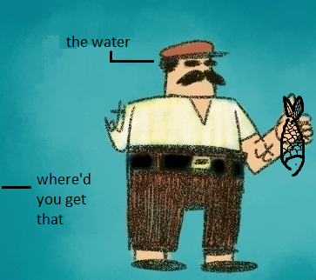
Saying you got your information from “The Internet” is like saying you got a fish from water
In the same vein, that asking someone where they got their information from, in this day & age, is like asking a man holding a fish next to a river where he found it.
Notes:
Means vs source. Two meanings of source, has to first be sought. Tv radia print. Credibility.

Slide 11
Everything is Accessible
The question is where to look.
Notes:
After all this critique of our society’s reluctance to get into the guts & grit web usage & functioning it would be embarrassing if I didn’t discuss some of the more practical aspects of – as is relevant for us – media dissemination, on the internet. I have compiled certain resources, using which, or simply of, will hopefully be of help to your daily lives, ik it is in mine.
Knowing Where to Look. If there is a will there is way etc etc. A working understanding of browsers is often not enough. But if you know where to look, everything can be found on the

Slide 12
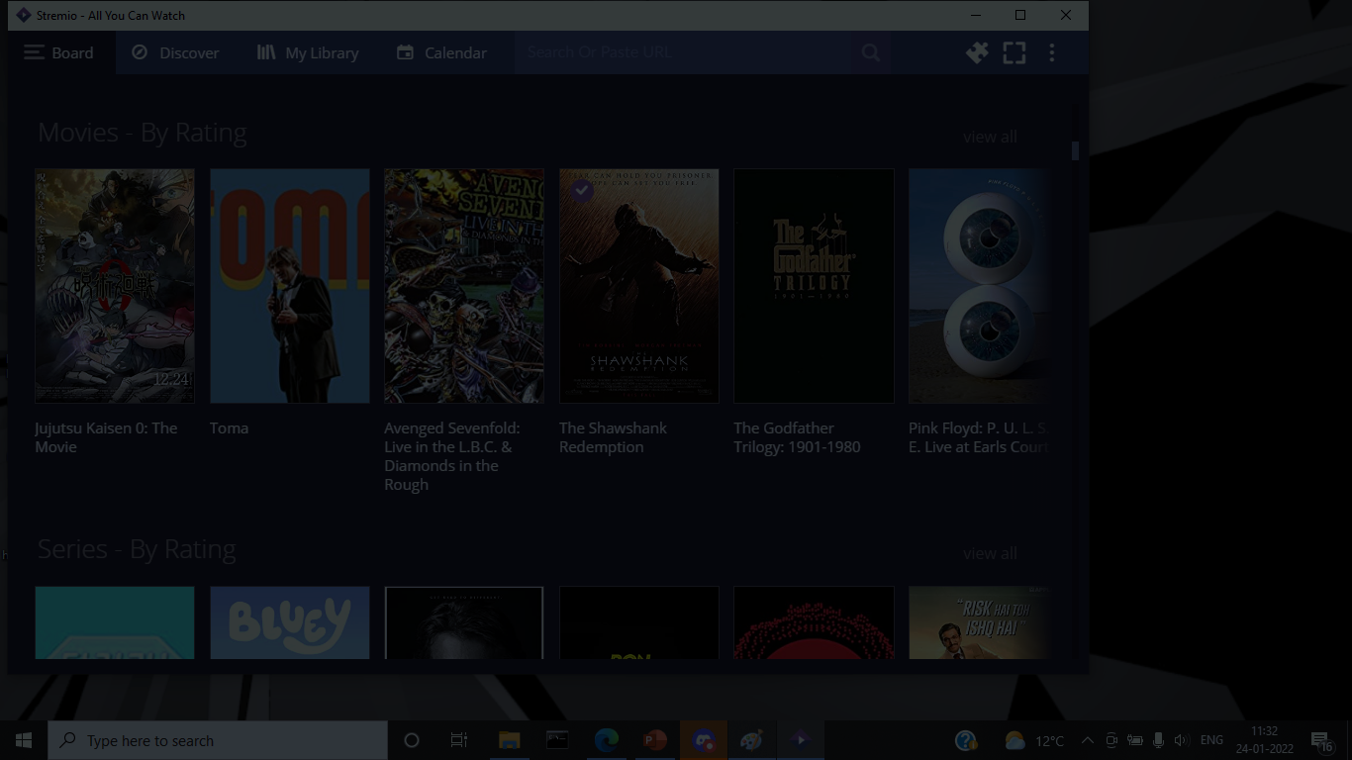

LibGen
Stremio
Academia.edu
12 Foot Ladder
indiankanoon.org
livelaw.in
Notes:
The pti business

Slide 13
Precedence
Journalistic Research as a Recursive Process
Notes:
Those who are familiar with the adversarial model of dispute resolution, i.e. the model that the Indian judiciary follows, will know that one of the key features of this system is that it is precedence oriented, i.e. judgements from previous rulings form as much a basis for new ones as the present legislation. Judicial decree is as much a law as ‘the law’ itself.

Slide 14
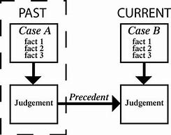







Those who are familiar with the adversarial model of dispute resolution (the model that the Indian judiciary follows) will know that one of the key features of this system is that it is precedence oriented, i.e. judgements from previous rulings form as much a basis for new ones as the legislation. Judicial decree is as much a law as ‘the law’ itself. A similar theme applies to journalistic research as well.
report
report

Slide 15
(blackboard)
Notes:
<Recursion diagram> “ultimately,”

Slide 16








Notes:
Everything that prints posts, but not everything that posts can afford to print (egs)
Case studys
Myth of credibility
Credence placed on print is legacy
Not a source of information but THE source of information
Means not source
No bigger journalistic resource than journalism that has already taken place
Adversarial law comparison
Ifnorance as barrier for acknowledging the true contributions of internet to journaliusm
In order to be a source, it must first be sought. active vs passive user interaction
Internet in relation to various types of journalism
No greater news source than news that’s already been broken

Slide 17
Thank You

